Slide 1

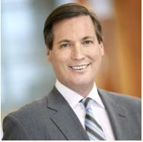
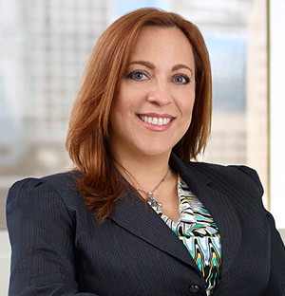
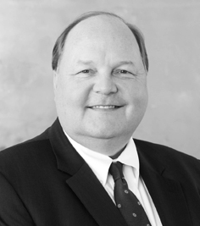
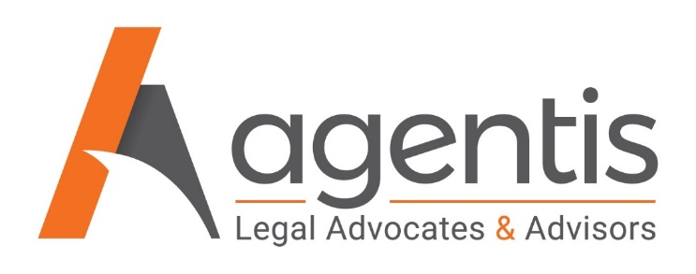

Part I: The Small Business Reorganization Act
What Your Small Business Clients Need to Know Right Now
Presented by:
Robert Charbonneau - Agentis Legal Advocates & Advisors
Jacqueline Calderín - Agentis Legal Advocates & Advisors
Daniel Sparks - Christian & Small LLP
Thursday, October 1st - 12:00 PM EDT / 4:00 PM GMT

Slide 2
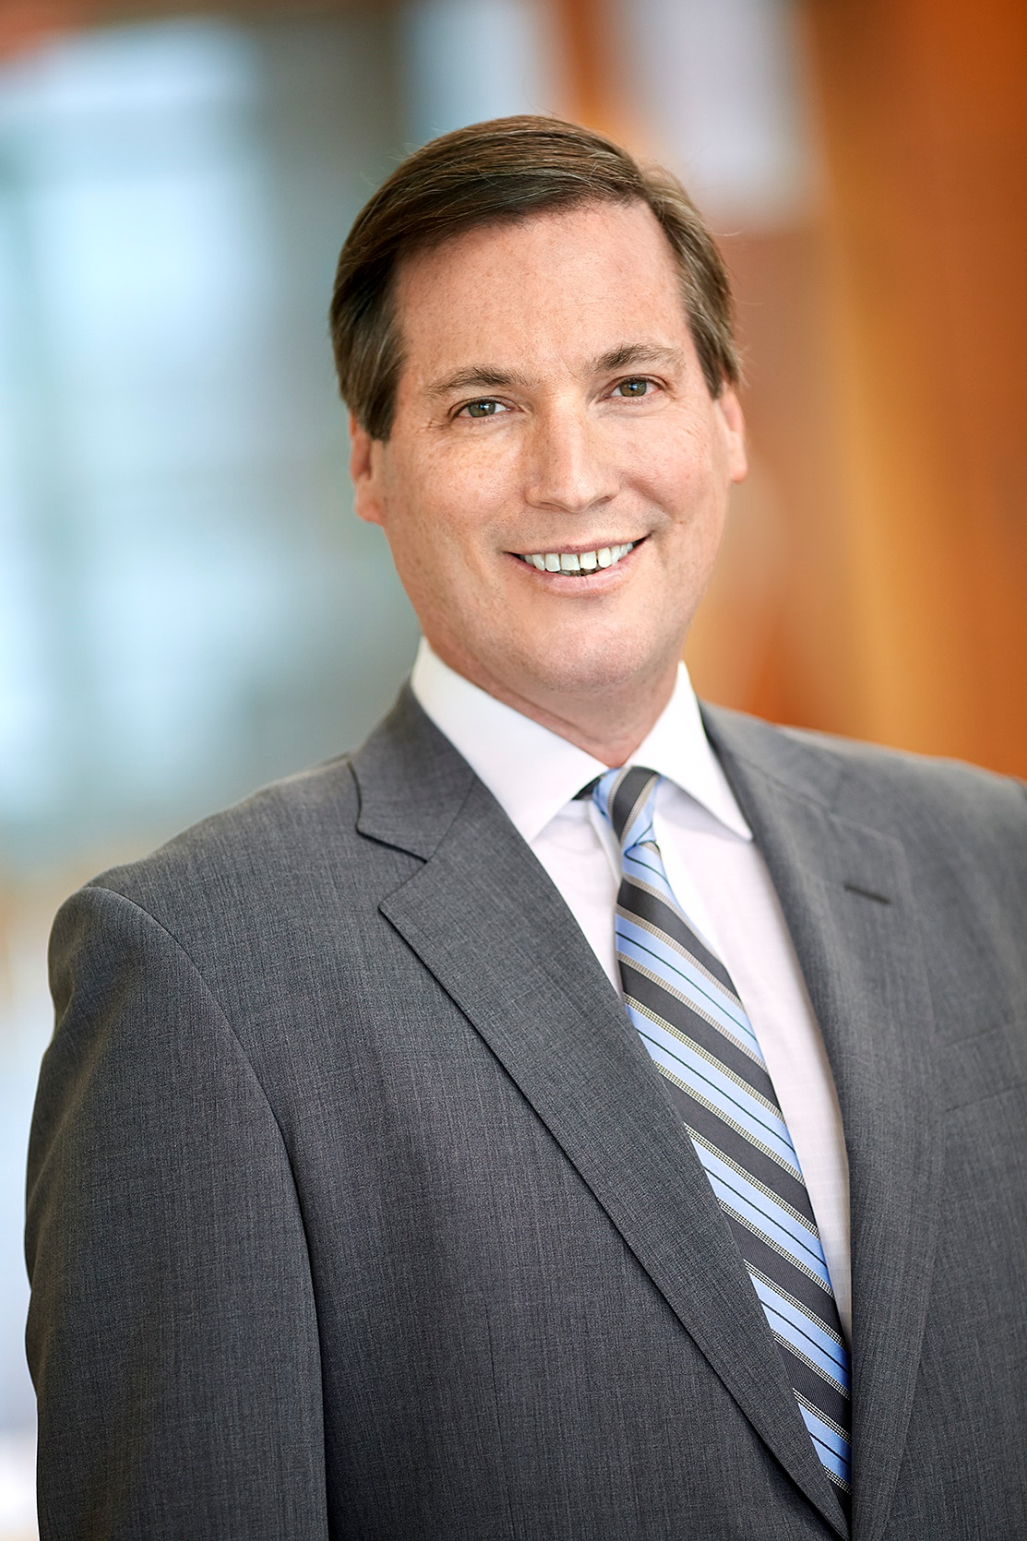
Robert P. Charbonneau Founding Member rpc@agentislaw.com
Robert Charbonneau is a founding member of the Firm. He concentrates his practice in troubled loan workouts, business restructuring and dispute resolution and insolvency matters. He has particularly broad experience representing statutory committees, including creditors’ committees, and funds purchasing distressed debt. Mr. Charbonneau is board certified in both business and consumer bankruptcy by the American Board of Certification.
REPRESENTATIVE MATTERS
Representation of BioNitrogen Holdings Corp. in a Chapter 11 protection matter
Representation of an ad hoc committee of construction lien claimants in the Fontainebleau Las Vegas bankruptcy case. Successfully argued for priming liens in excess of $300 million over the priority of nearly $1 billion in existing bank debt before the Nevada Supreme Court and the two federal courts in Florida
Representation of the creditors committee in Hear USA, a publicly traded hearing aid manufacturer and retailer
Served as counsel to the statutory committee of Deposit Holders in the Levitt Homes bankruptcy case
Lead Debtor’s counsel in the Pan American Hospital case, then the largest independent not for profit hospital in South Florida
Lead Committee Counsel in both the Suncruz Casinos and ITG Vegas cases involving fleets of gambling vessels
On-going representations across the country of a hedge fund in the enforcement of their debt instruments in various Chapter 11 proceedings
EDUCATION
J.D., Boston College Law School
B.A., University of Florida
ADMISSIONS
Florida Bar
United States District Court for the Southern District of Florida
United States District Court for the Middle District of Florida
Eleventh Circuit Court of Appeals
Supreme Court of the United States of America

Slide 3
Jacqueline Calderín Founding Member jc@agentislaw.com
Jacqueline Calderín is a founding member and current managing partner of the Firm. She represents debtors, committees, secured creditors, and purchasers of assets in the areas of bankruptcy, insolvency, and restructuring in both in-court and out of court proceedings. In addition to her law practice, Jacqui serves as a court-appointed fiduciary. In 2011, she was appointed by the Department of Justice’s United States Trustee Program as a panel trustee to supervise and administer bankruptcy cases in the Southern District of Florida.
REPRESENTATIVE MATTERS
Counsel to Debtor in Possession for largest paper recycling company in South Florida in chapter 11 Reorganization
Counsel to Debtor in Possession for community hospital in a successful chapter 11 Reorganization
Counsel to Debtors in Possession in several healthcare-related in chapter 11 cases
Counsel to numerous high-net worth individuals, including attorneys, builders, and physicians in their own successful chapter 11 reorganizations
Counsel to several private school Debtors in Possession in their respective chapter 11 reorganizations
Counsel to Creditors’ Committee for a large telecommunications company in a successful chapter 11 reorganization
Appointed Trustee in numerous business cases, including an operating blood processing laboratory, national cabinet manufacturer, real estate brokerage house, plumbing and engineering company, and others
Counsel to Deposit Holder committee in a chapter 11 for national residential developer
EDUCATION
J.D., University of Miami School of Law
B.A., magna cum laude, Florida International University
ADMISSIONS
Florida Bar
United States District Court for the Southern District of Florida
United States District Court for the Middle District of Florida

Slide 4
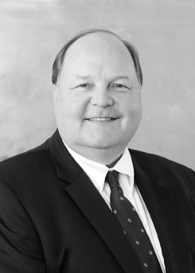
Daniel D. Sparks Partner ddsparks@csattorneys.com
Dan Sparks is head of Christian & Small’s Creditor & Lender Rights Practice Group. He focuses his practice in the areas of bankruptcy and business litigation involving creditors’ rights, consumer finance, lender liability, commercial contracts, and injunctive relief. Dan represents commercial lenders, debt buyers, corporations, Trustees, individuals and other secured and unsecured creditors in all aspects of commercial litigation, loan workouts, restructurings and closings, asset recovery, foreclosure, and adversary proceedings in bankruptcy. He spends a significant amount of his time representing creditors in all bankruptcy courts in Alabama and the Southeast.
AWARDS & RECOGNITIONS
AV® Preeminent Peer Review Rating from Martindale-Hubbell
Recognized in Chambers USA for Bankruptcy/Restructuring: Alabama
Selected by The Best Lawyers in America® in 2018 as “Lawyer of the Year” for Bankruptcy & Creditor Debtor Rights/Insolvency & Reorganization Law
Selected for inclusion in The Best Lawyers in America® 2009 thru 2021 in the fields of Banking and Finance Law; 2009 thru 2011 Litigation – Banking and Finance, Litigation – Bankruptcy, Mortgage Banking Foreclosure Law; 2009 – 2010 Bankruptcy and Creditor Debtor Rights/Insolvency and Reorganization Law; Commercial Litigation 2009
Selected for inclusion in Alabama Super Lawyers® Top 50 Attorneys in Alabama and Top 50 Attorneys in Birmingham
Selected for inclusion in Alabama Super Lawyers® in the field of Bankruptcy and Creditor/Debtor Rights; in Mid-South Region Super Lawyers in 2016-2019 in the field of Bankruptcy, Business
Listed as one of the Birmingham Business Journal’s “Best of the Birmingham Bar”
Listed as “Top Attorney” in fields of banking and bankruptcy for Birmingham Magazine
EDUCATION
J.D., Samford University Cumberland School of Law
B.A., University of Georgia
ADMISSIONS
Alabama Bar
Georgia Bar
U.S. Court of Appeals, 11th Circuit
U.S. District Court, Northern District of Alabama
U.S. District Court, Middle District of Alabama
U.S. District Court, Southern District of Alabama
Georgia State Supreme Court
Georgia Court of Civil Appeals

Slide 5

Subchapter V Case Timeline
Petition Date
§ 341 Meeting of Creditors
Required Status Conference
Government
Proof of Claim
Small Business Financials: Append to petition: most recent (i) balance sheet; (ii) statement of operations; (iii) cash-flow statement; and (iv) federal income tax return; or a statement made under penalty of perjury that none available.
11 U.S.C. § 1187(a) 11 U.S.C. § 1116(1)(A), (B)
Plan
Meeting of Creditors and Equity Security holders (to be set by Court)
11 U.S.C. § 341(a)
Not later than 90 days after the order for relief, file Plan
11 U.S.C. § 1189
No deadline for obtaining confirmation
Not later than 180 days after the order of relief, or 60 days after the date of the filing of the tax return
11 U.S.C. § 3002(c)(1)
Not later than 60 days after the entry of the order for relief, the court shall hold a status conference
(to be set by Court)
11 U.S.C. § 1188(a)
Confirmation but the court, on the request of any party to such contract or lease, may order to determine within a specified period of time whether to assume or reject such contract or lease.
11 U.S.C. 365(d)(2)
Debtor’s Pre-Status Conference Report
Proof of Claim
(non governmental)
Assume / Reject Executory Contracts
Initial Debtor Interview
Within 7 days the UST will conduct the Initial Debtor Interview
Debtor to file and serve Report 14 days before the date of the § 1888(a) status conference
11 U.S.C. § 1188(c)
Not later than 70 days
after the order of relief
11 U.S.C. § 3002(c)

Slide 6
Differences between a Small Business Debtor Reorganization and Other Types of Reorganization

Slide 7
Differences between a Small Business Debtor Reorganization and Other Types of Reorganization

Slide 8
Differences between a Small Business Debtor Reorganization and Other Types of Reorganization

